Slide 1


Reasoning Revolution Cracking the Code of LLM Intelligence
Asim Munawar
IBM TJ Watson Research Center, New York
1st International Workshop on
Neuro-Symbolic Software
Engineering (May 3, 2025)

Slide 2


What we have
What was promised

Slide 3



No final verdicts — this is an evolving story.
I won’t show LLM failures… okay, maybe just a few 😉
Confused at the end? Perfect.
That means you really got it.
Reasoning with LLMs
Why Reasoning Matters?
Benchmarks & Challenges
Large Reasoning Models
Role of Neuro-Symbolic AI

Slide 4
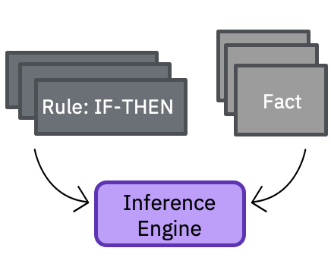
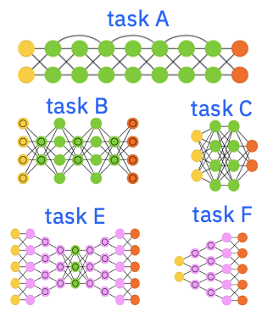
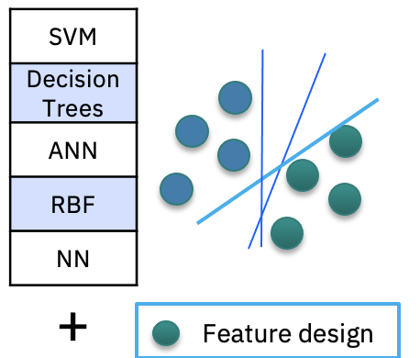
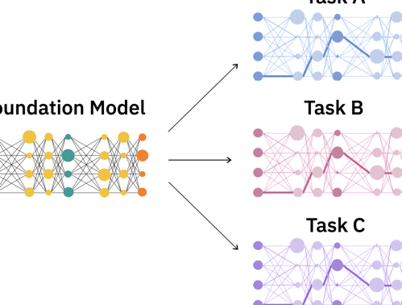
1980s
Big data
1980s to ~2010s
Massive labeled data + Compute
2010+
Self-supervision at scale
+
Massive unlabeled data + Compute
2017+
Expert systems
Rule engines
Machine learning
ML algorithms
Task-specific decision boundaries
Dimension reduction
Feature engineering
Deep learning
Network architectures
Task-specific decision boundaries + feature representations
Large Language Models
Base model
Adaptable decision boundaries and feature representations
Notes:
Generative AI represents the latest innovation in the long history of the artificial intelligence (AI) journey on data representations. It began with expert systems and early inference engines in the 1980s using symbolic representations of data.
The modern era of AI and machine learning (ML) began in the 1980s and culminated in deep learning in the later part of the 2010s. These models required a massive amount of labeled data to train. The resulting models were targeted for specific tasks and while these models could be successful, they were expensive (finding and labelling sufficient data) and not easily transferrable to other tasks not initially thought about when model training began. Solving different tasks (even though they may be related) required another set of labeled data and retraining. Such task-specific learning models were not scalable and became expensive. This is analogous to training an intern to understand and interpret legal documents versus medical content. These industries have different vocabularies, ways of thinking, and ways to resolve gray areas, among other differences.
New ideas, innovation, and new techniques began to emerge in the late 2010s to provide the next leap in AI modelling – foundation models and generative AI. Unlike the traditional ML and AI models, foundation models are trained on massive but unlabeled data sets and use self-supervised learning. Foundation models have a much broader base (foundation). Today, Large Language Models (LLMs, a type of foundation model) have proven to be very useful, especially in initial applications for areas in natural language processing (NLP) tasks.

Slide 5
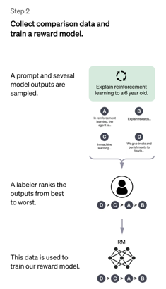
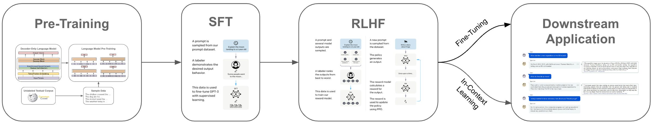
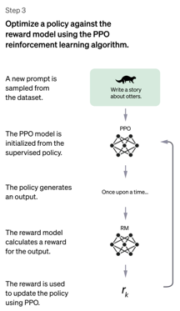
LLM Training
Reward Model
Preference Pairs
Instruction – Good response – Bad response
Internet scale unstructured data
Instruction Response
pairs
Diverse Instructions

Slide 6
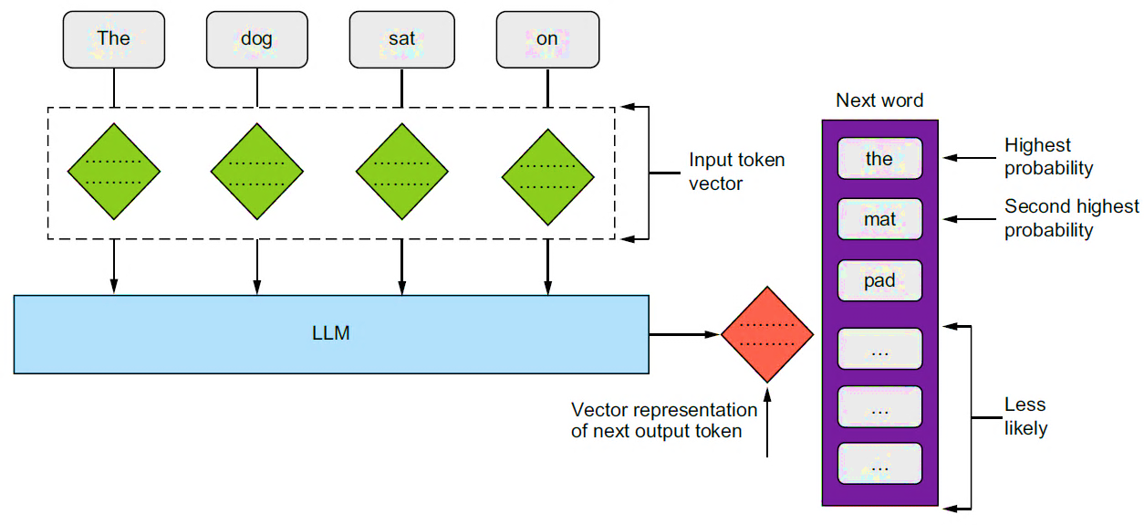
LLMs are Next Token Predictors
sdf

Slide 7
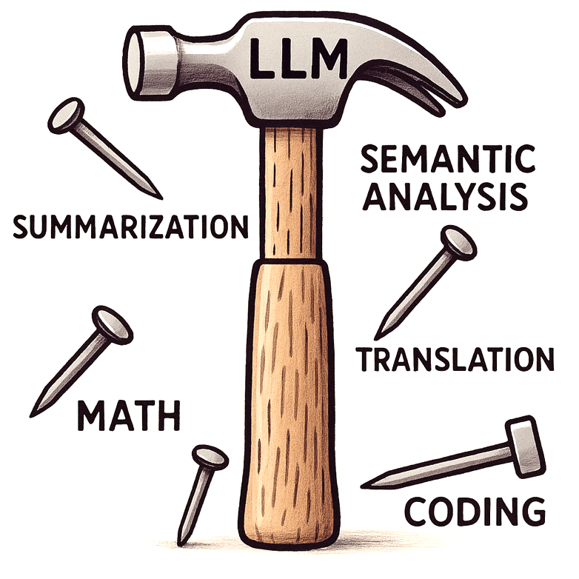
"When the only tool you have is a hammer, every problem looks like a nail.”
LLMs are today’s hammer — so easy to use, every problem starts to look like next-token prediction.
But true intelligence demands more than just completing the next word.

Slide 8
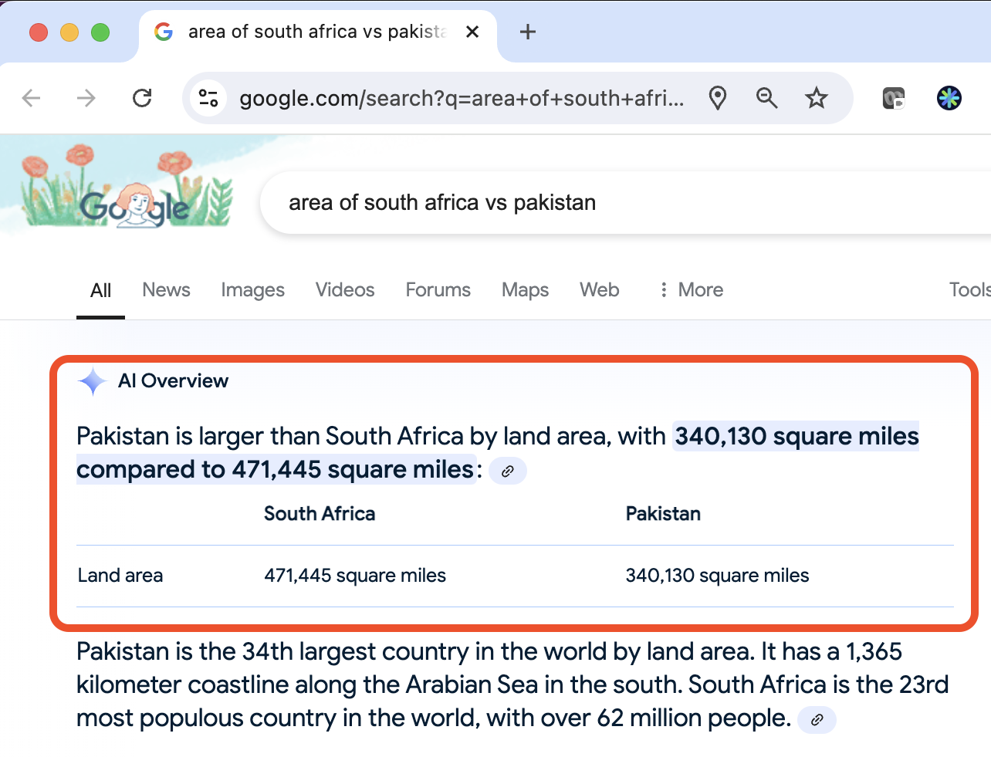
Reasoning with Large Language Models

Slide 9
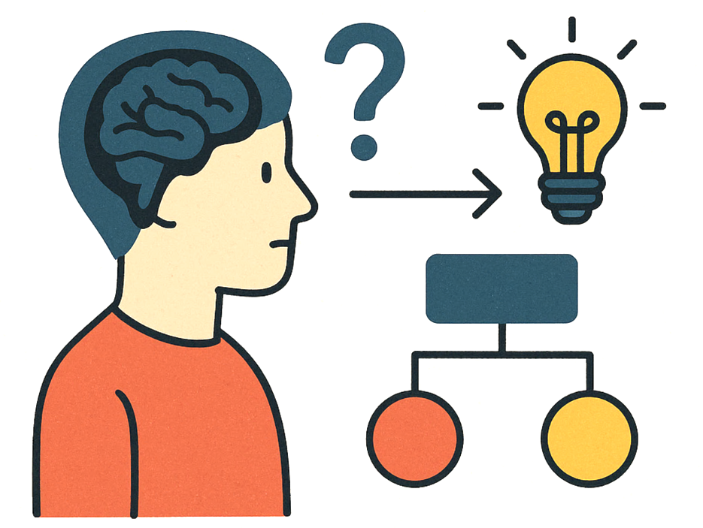
What is Reasoning?
Process of thinking about something in a logical and systematic way, using evidence and past experiences to reach a conclusion or make a decision.
Formal Reasoning
Symbolic logic, math
Precise, rule-based
Challenges: complexity, real-world ambiguity
Natural Language Reasoning (aka. Informal Reasoning)
Human-like understanding
Contextual, nuanced
Challenges: ambiguity, subjectivity
So, isn’t everything reasoning then?

Slide 10
Reasoning
The ability to think step by step and infer new conclusions from existing clues.
Enables us to make sense of incomplete information and answer questions beyond what’s explicitly given.
Tells the story behind the scene
vs.
Knowledge
Drawn from past experiences and stored information.
Labels the scene
Example: You walk into the kitchen and see a boiling kettle, but no one around.
You infer
Someone was just here.
Tea or coffee is being prepared.
It’s probably break time.
You recognize
That it’s a kettle.
That steam means it’s boiling.
That people usually boil water for tea or coffee.

Slide 11
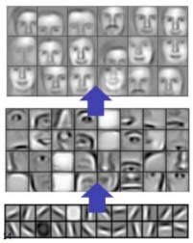
Reasoning also helps with Explainability
Global Explainability
Analyze the structure of the model to understand its capabilities.
Which input features contribute most to the model's output.
Local Explainability
Explaining the prediction for a single data point.
Counterfactual Explanations - What would need to change in the input to alter the model's prediction.
Notes:
Local: Why the model made a particular decision.

Slide 12
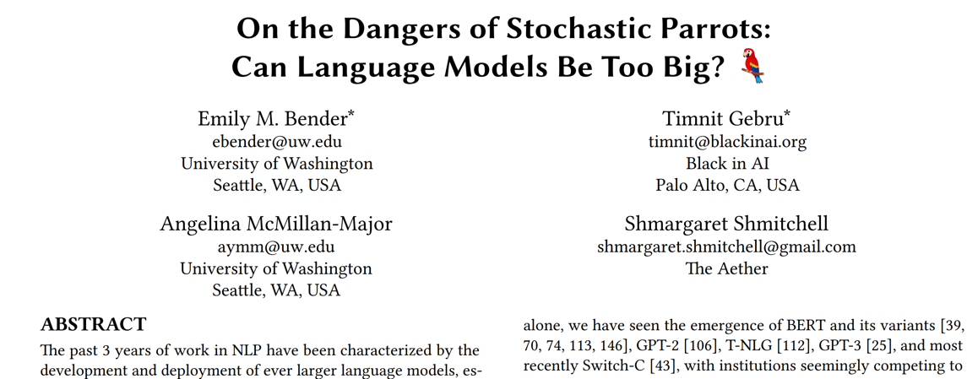
Do LLMs think/reason like humans?
Language Models
Predict the next token statistically
No understanding, intent, or awareness
No memory of past experiences (unless explicitly given)
Output is shaped by training data, not lived experience
Humans
Reason through problems with logic and emotion
Draw on memory, world knowledge, and imagination
Speak with goals, motives, and sometimes hidden agendas
Often know what they want to say before speaking

Slide 13
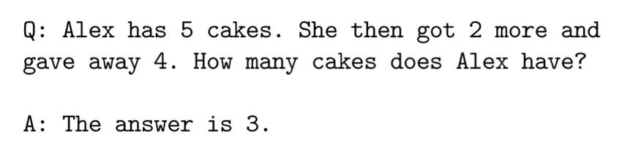
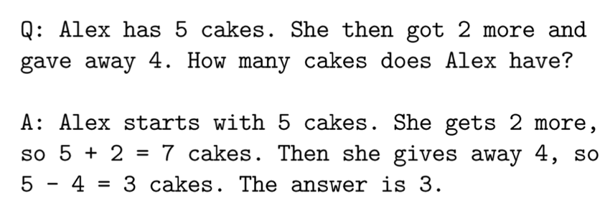
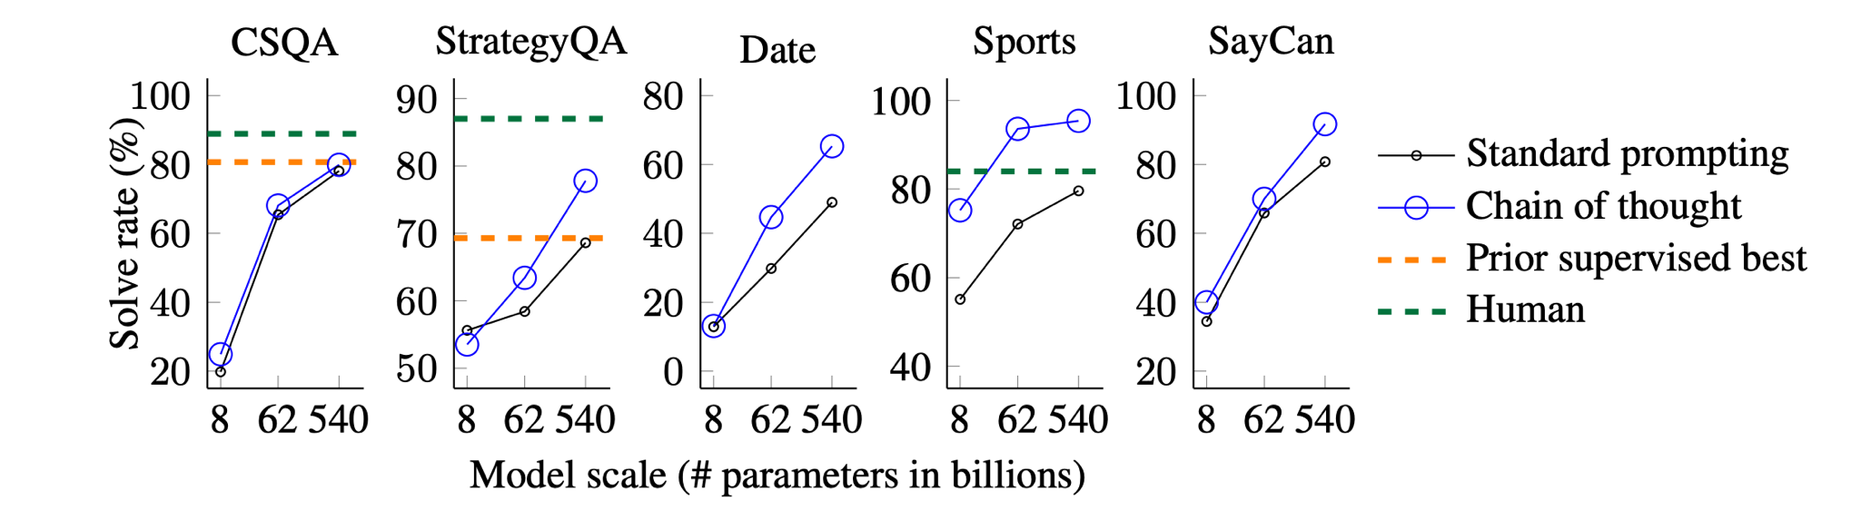
Chain of Thought - CoT
Step-by-Step Reasoning
Improves Accuracy
Explainability
Debugging
Standard prompting
Chain-of-thought prompting
[Wei et al 2022]

Slide 14
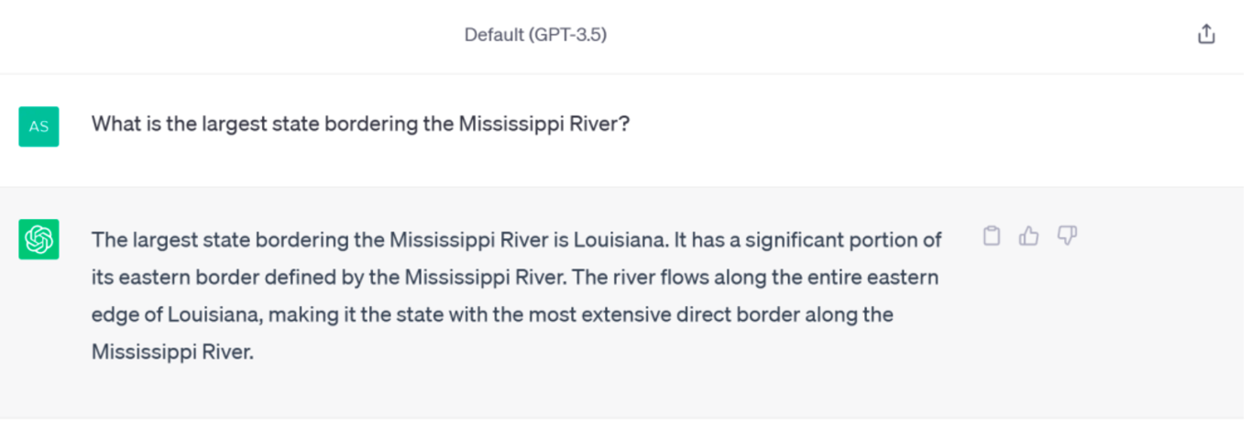
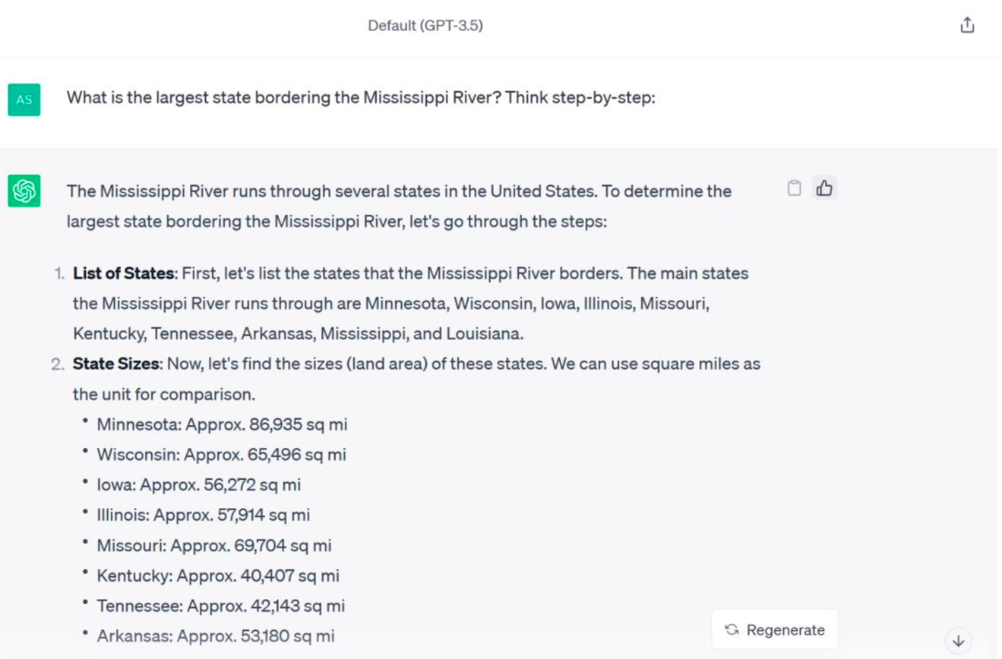
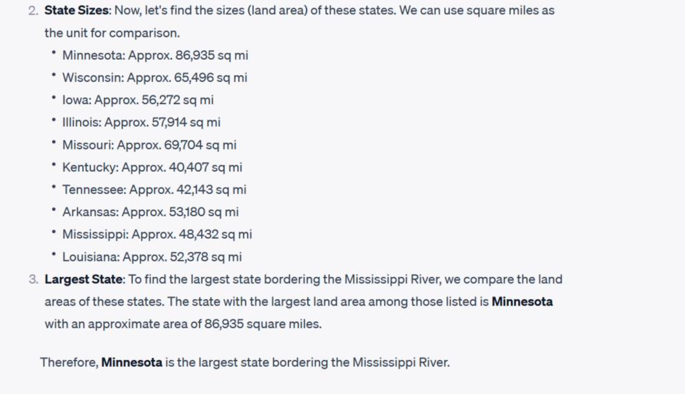

Zero-shot CoT
[Kojima et al 2022]

Slide 15
Advanced CoTs (without verifiers)
Input
Input
Input
Output
Output
Output
Simple Prompting
CoT
CoT with Self Consistency

Slide 16
Advanced CoTs (with verifiers)
Input
Input
Input
Output
Tree of Thought
Best of N
Monte-Carlo Roll-outs to check each step of CoT

Slide 17
Use CoTs to train a model
Input
Now, we would like to learn a model from these CoTs
We want a model to generate good verified solutions as frequently as it can
This is combinatorically hard problem
Maximum Likelihood Problem
Slide Inspired by: Sasha Rush – o1 tutorial

Slide 18

So, LLMs can Reason

Slide 19
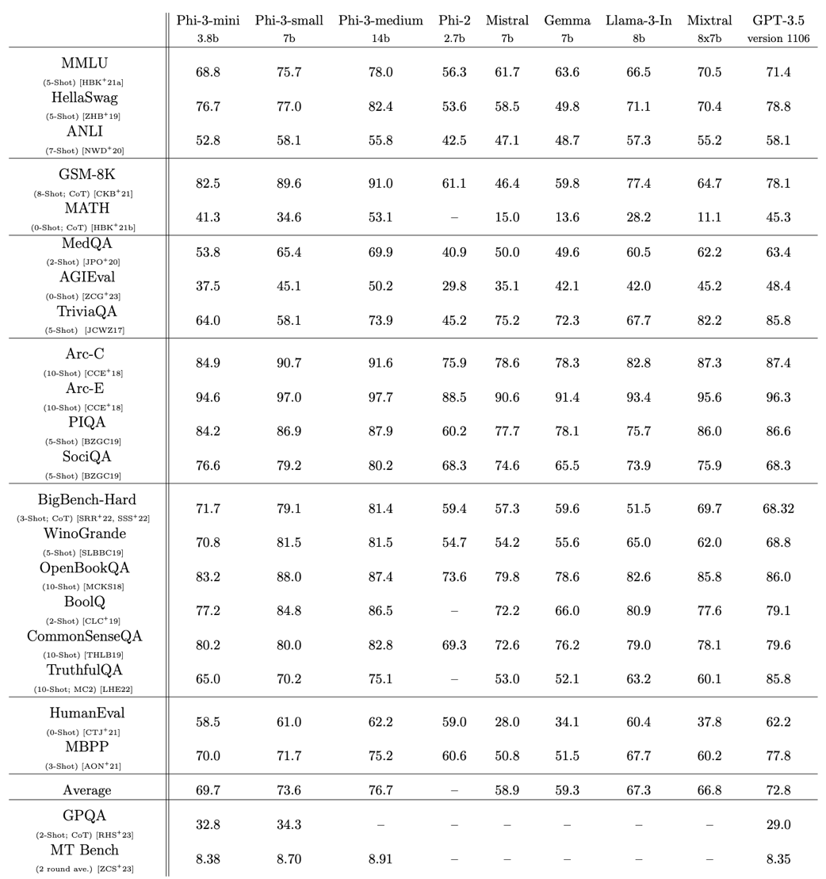
How do we even Evaluate?
LLMs do perform well on many benchmarks, sometimes better than a subject matter expert (SME)
Dataset | Full Name | Description
gsm8k_cot | Grade School Math 8K (Chain of Thought) | Grade-school math problems requiring step-by-step reasoning for solutions.
bbh_cot_fewshot | Big Bench Hard (Few-shot Chain of Thought) | Challenging reasoning tasks with few-shot chain-of-thought prompts.
ai2_arc | AI2 Reasoning Challenge | A question-answering benchmark testing scientific and commonsense reasoning.
mmlu | Massive Multitask Language Understanding | Multi-task benchmark for language understanding across diverse knowledge domains.
commonsense_qa | Commonsense Question Answering | Multiple-choice questions assessing everyday commonsense knowledge.
hellaswag | HellaSwag Commonsense Completion | A commonsense reasoning task for choosing the most plausible sentence continuation.
openbookqa | OpenBook Question Answering | Open-book multiple-choice questions assessing science and general knowledge reasoning.
piqa | Physical Interaction Question Answering | Physical reasoning task focusing on everyday physical interactions and intuitive physics.
race | Reading Comprehension Dataset | Reading comprehension dataset with questions based on middle and high school exams.
social_iqa | Social Interaction Question Answering | Social commonsense reasoning tasks requiring understanding of interpersonal scenarios.
Abdin, M., et al. (2024). Phi-3 Technical Report: A Highly Capable Language Model Locally on Your Phone. arXiv. https://arxiv.org/abs/2404.14219

Slide 20
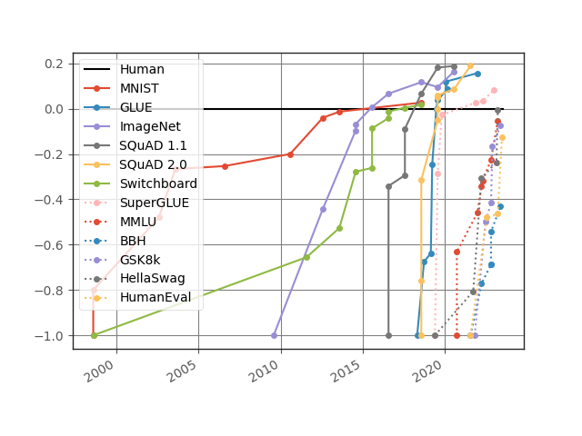
Potential Confounders
“LLMs can appear to reason but their core function is more like sophisticated pattern matching and information retrieval rather than true, human-like reasoning”
Subbarao Kambhampati - ASU
Some benchmarks focus on limited domains (e.g. Math, Code)
Usually verify only the answer, not reasoning.
Templated benchmarks can be deceiving
Contamination: reasoning ability or retrieval ability
May exploit artifacts and shortcuts
https://contextual.ai/news/plotting-progress-in-ai/

Slide 21
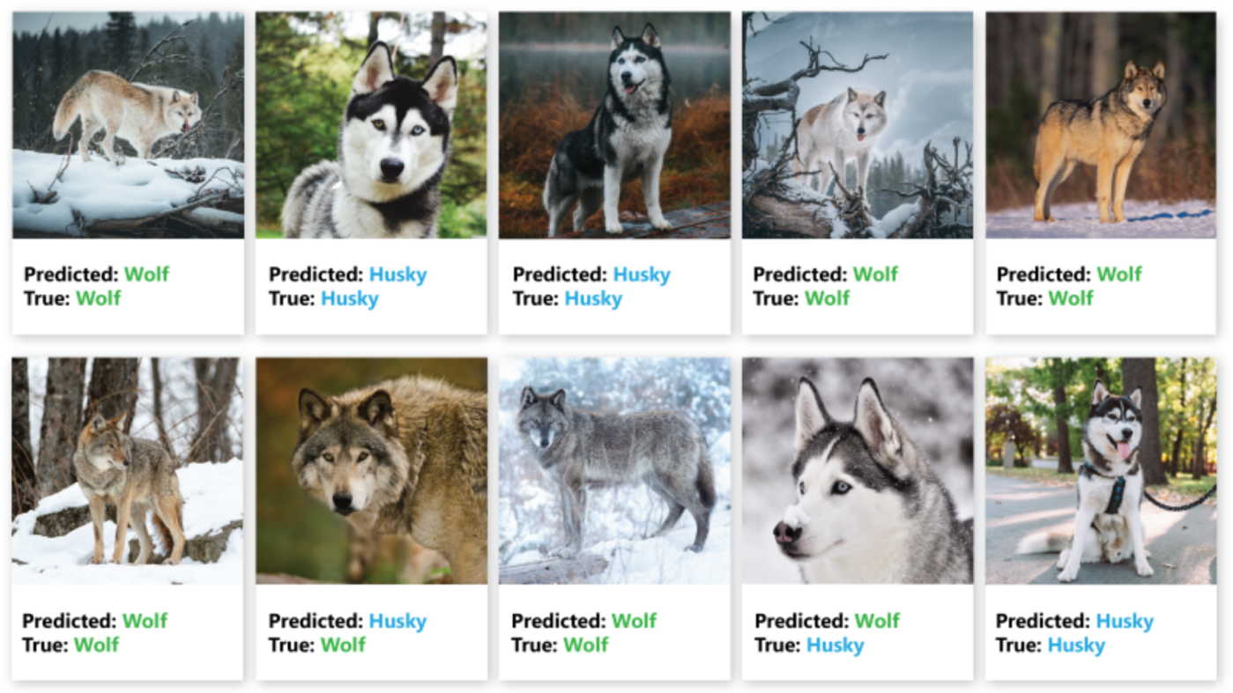


Can AI hack a Dataset?
Attention?
https://carpentries-incubator.github.io/data-science-ai-senior-researchers/05-Problems-with-AI/index.html

Slide 22
Types of Reasoning
Induction – Learning from Examples
LLMs generalize from large-scale pretraining data, capturing statistical patterns across language.
LLM Mechanism:
Pretraining Example:
Observation: The sun rises every day
Generalization: The sun always rises
Deduction – Applying Rules to Cases (Theorem Proving)
LLMs can simulate rule-based reasoning when given structured prompts.
LLM Mechanism:
Prompt Engineering
Example:
Rule: All humans are mortal
Fact: Socrates is human
Conclusion: Socrates is mortal
Abduction – Inferring the Most Likely Explanation (Probabilistic)
LLMs generate plausible completions based on partial input during inference.
LLM Mechanism:
Inference-Time Generation
Example:
Observation: The grass is wet
Likely cause: It rained last night

Slide 23
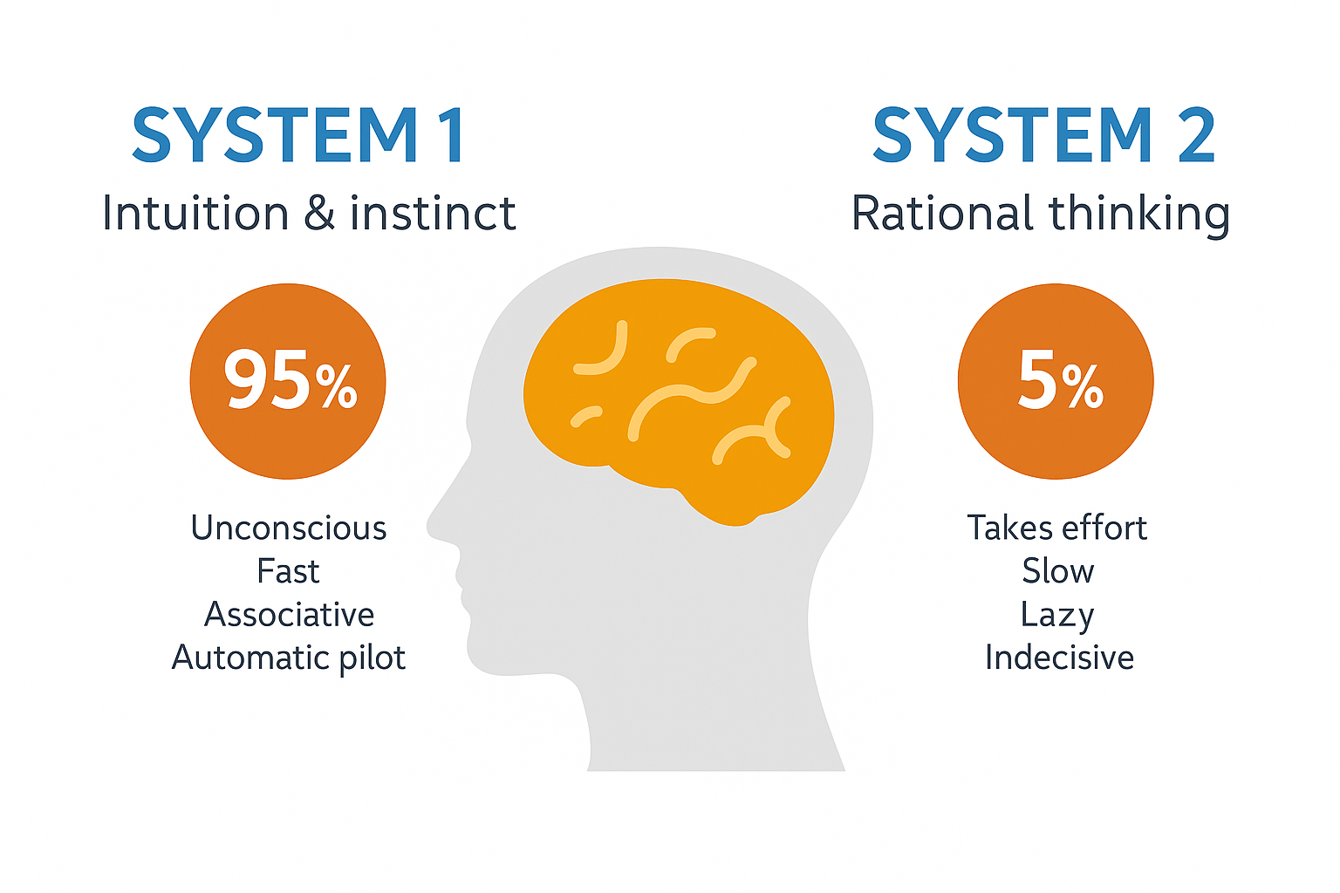


Real-life scenarios need both System 1 and System 2
Overtime System2 tasks can become System1
Generate an image that shows a real-world scenario where both system 1 and system 2 thinking is required.
OpenAI (22 Apr 2025)
Notes:
System 1 and System 2
The psychologist Daniel Kahenman popularized two kinds of thinking: System 1 and System 2. Yan LeCun and others have been very clear. If deep neural networks are doing anything like reasoning at all, it’s strictly System 1. That’s not an intuitive judgement, either, the research bears this out. Deep neural networks are not doing symbolic reasoning (a little louder for the breathless folks in the back).
System 1: Fast, Automatic Reasoning
Automatic: Processes information automatically without conscious control.
Fast: Decisions and assessments are made quickly.
Heuristic-based: Often relies on rules of thumb, mental shortcuts, or stereotypes.
Emotion-driven: Emotions and gut feelings can heavily influence decisions.
Effortless: Requires little or no cognitive effort.
Examples: Recognizing faces, reading emotions, basic arithmetic like 2+2, and simple motor skills are often driven by System 1.
System 2: Slow, Deliberative Reasoning
Conscious: Requires active, deliberate cognitive effort.
Slow: Takes time to process information and make decisions.
Logical: Tends to rely on formal methods of reasoning, following rules or structured approaches.
Resource-Intensive: Consumes more cognitive resources and energy.
Controlled: Can follow rules, compare options, weigh pros and cons, and reason logically.
Examples: Solving complex math problems, making high-stakes decisions, and evaluating complicated situations typically involve System 2 reasoning.
Somehow, humans do both. Though, if you watch the same YouTube channels my kids do, you might wonder if humans do any System 2 at all. But let’s be generous.
System 1 + 2
Statistical models of intelligence like deep neural networks roughly equate to System 1 thinking. Symbolic models of intelligence roughly equate to System 2 thinking. The field of neurosymbolic AI is looking for ways to create intelligent systems with System 1 and System 2 capabilities. Call it the holy grail of machine intelligence, just one more next step in machine intelligence, call it J.A.R.V.I.S. Whatever it is, the promise is huge. Uniting the strengths of statistical and symbolic AI in a fully integrated way really could give us systems that learn on their own, truly reason, solve a wider range of problems, and do so in a way that is more interpretable and explainable to us. Or so the theory goes.
It's a great theory. Many of the biggest names in AI research seem to think so. And the more I read the more interested I get. The possibilities are exciting. But even more, it’s an intellectually exciting goal.

Slide 24

Large Reasoning Models (LRMs)
I have 2 bananas in the room, 1 fell down. How many bananas are left in the room?
----------------------
So I have this problem: "I have 2 bananas in the room, 1 fell down. How many bananas are left in the room?" Hmm, it seems straightforward, but I want to make sure I understand it correctly.
First, there are 2 bananas in the room. That's clear. Then, it says 1 fell down. Now, did it fall out of the room or is it still in the room but maybe on the floor?
Wait, the question is "how many bananas are left in the room?" So, if one fell down, but it's still in the room, just perhaps not on the table or wherever they were originally, then there should still be 2 bananas in the room.
But maybe "fell down" implies that it left the room. Let me think about that.
The problem doesn't specify where the banana fell. It just says "fell down." So, if it's in the room and it fell down, it's probably still in the room, just maybe on the floor.
Alternatively, if the room has only one exit and the banana fell towards that exit and rolled out, then it might be out of the room.
But, without more information, I think the safest assumption is that both bananas are still in the room, even if one of them is on the floor.
So, the answer should be 2 bananas are left in the room.
Wait a minute, another thought. Maybe "fell down" means it was dropped and stayed where it was, so still in the room.
Alternatively, perhaps "fell down" means it was thrown or dropped and left the room.
But again, without specific information, I think assuming it's still in the room is reasonable.
Alternatively, perhaps the problem is testing basic subtraction, and "fell down" means it's no longer present in the room, so you subtract one from two, getting one.
But that seems a bit simplistic for a problem like this.
Alternatively, maybe there's a trick here. Maybe "fell down" doesn't mean it left the room, so the number remains two.
Hmm.
Alternatively, perhaps the problem is considering only bananas that are intact or in their original position, and the one that fell down is no longer considered "in the room" in the same way.
But that seems like splitting hairs.
I think the most straightforward interpretation is that both bananas are still in the room, just one is on the floor.
Therefore, the answer is 2 bananas are left in the room.
Alternatively, if "fell down" means it left the room, then it would be 1 banana left in the room.
But based on the information given, I think 2 is the better answer.
Final Answer
2

Slide 25
 | Large Language Models | Large Reasoning Models | Symbolic AI
Scaling Paradigm | Next-Token, Simple CoTs | Complex CoTs, Search | Rule-based, no scaling through data
Reasoning Type | System 1 | System 2 (Natural language based) | System 2 (Explicit logic based)
Interaction | Tokens are helpful | So called Thinking tokens can be overwhelming (hidden for some models) | Human interpretable symbols and logic trees
Famous Models/Systems | GPT4o, Llama, DeepSeek-V3, Mistral | OpenAI o1/o3, DeepSeek-R1, Sky-T1, QwQ | Prolog, Cyc, SOAR, OpenCog

Slide 26
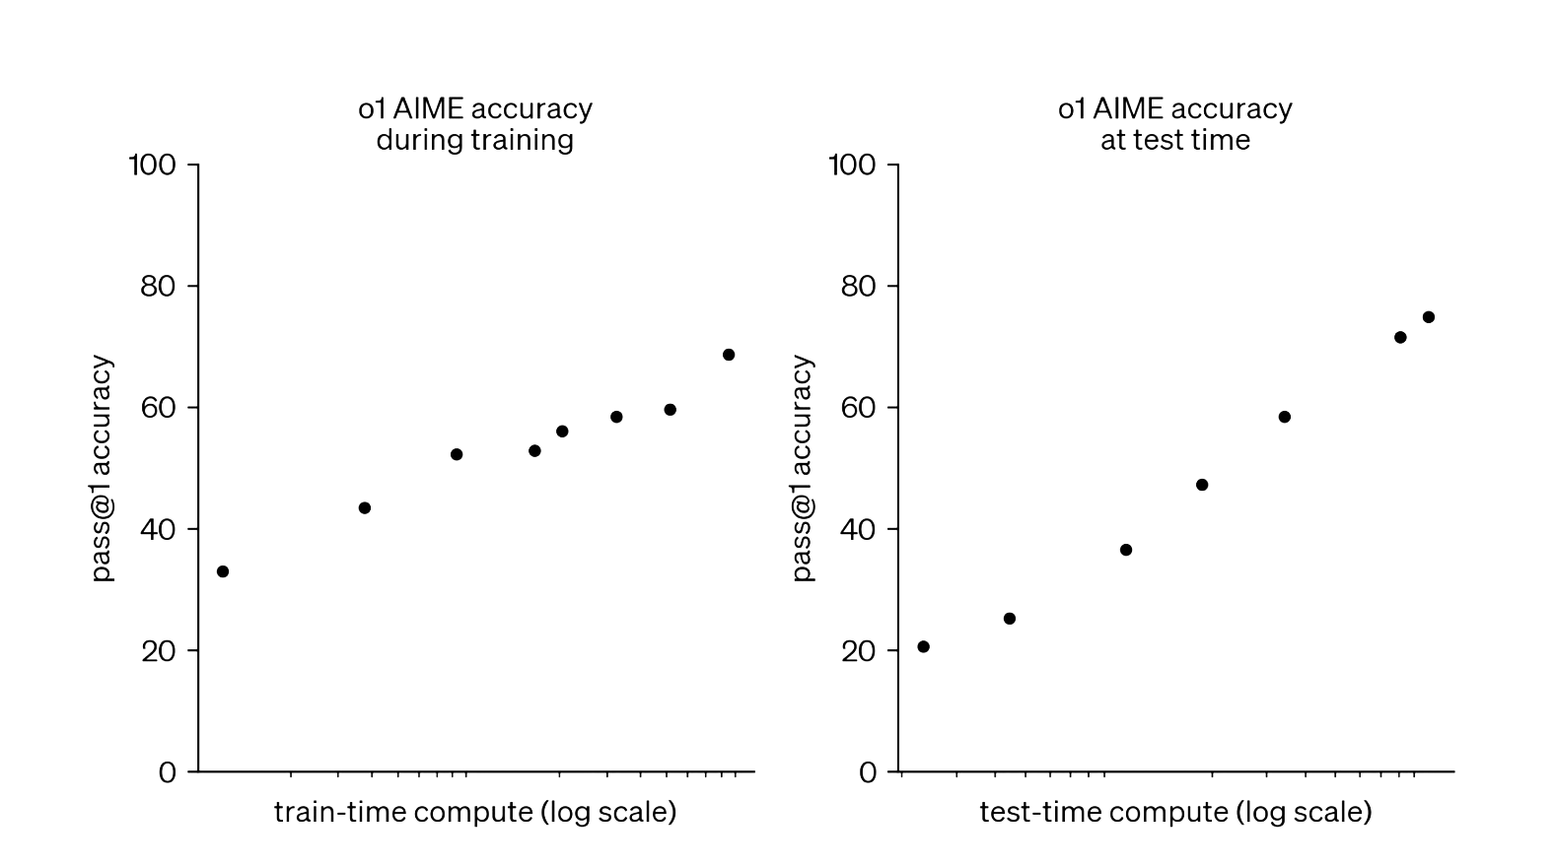
Training vs. Inference Time Scaling
Better Data
Difficulty
Quality
SDG
Architecture
Filtering
ORMs
Alignment
Search algorithms
Long CoTs
Agentic Behavior
Tools
PRMs
Self-Correction
Reflection
OpenAI 2024 Blog

Slide 27
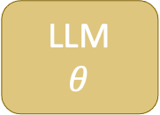
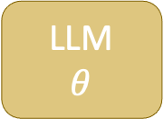

Test-Time Scaling Approaches
Generate multiple answers
Selector
Majority based
(Self consistency)
Incremental
(MCTS, Beam Search)
LLM
$$θ$$
Prompt
Solution
No Guarantees
If we have access to a lot of compute and time at inference time
Verifier
Formal
Learned
Synthesized
LLM
$$θ$$
Prompt
Solution
Generate a candidate solution
Full/Partial
Guarantees
Feedback
LLM
$$θ$$
Prompt
Solution
LongCoT
Full/Partial
Guarantees
Subbarao Kambhampati - ASU

Slide 28
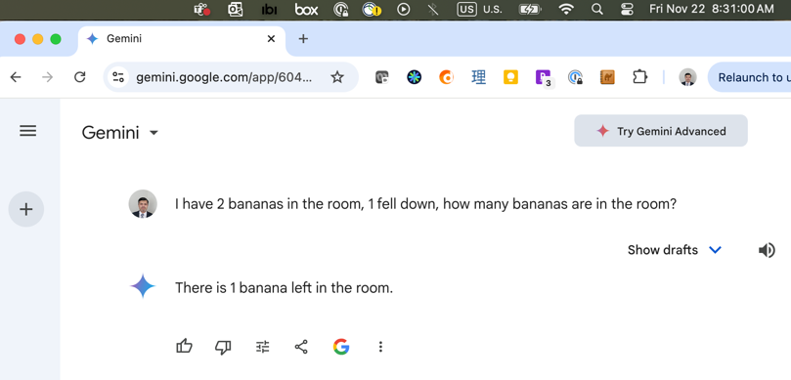
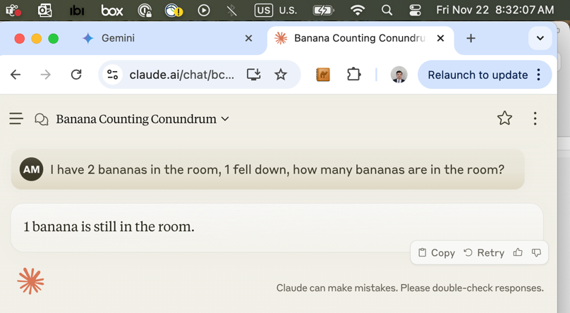
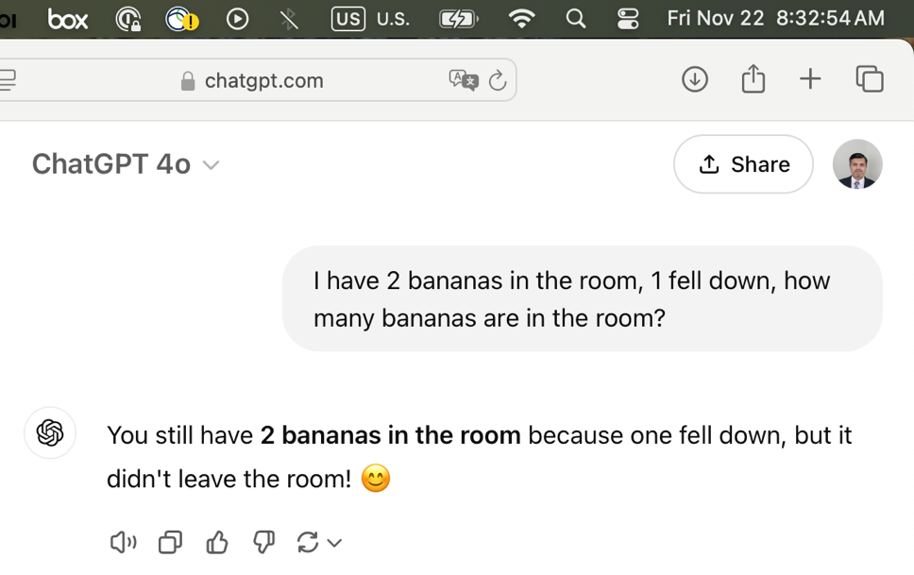
How to Train an LRM?

Slide 29


-o1 | -R1 and Beyond
OpenAI-o1 was the first successful LRM
Why DeepSeek-R1 got so much attention?
Full pipeline for building LRMs
Open sourced the models
Algorithmic advances

Slide 30
DeepSeek-V3
Qwen 1.5, 7, 14, 32b
Llama 8, 70b
1000s of CoT examples with Human in the Loop Curation
Fine-tune
Good model to start RL
Reasoning: ~144k CoT GSM8K, MATH, etc
GRPO with 2 rule-based rewards
Fine-tune with Distillation
Filter
Stronger reasoning, weaker general capabilities
Distilled R1 Models
~200k non-reasoning examples (writing, QA)
Fine-tune
~600k quality reasoning traces
Stronger reasoning, restored general capabilities
Reasoning + General: Mix of data types
GRPO with rule-based and RM for non-reasoning
DeepSeek-R1
Reasoning while prioritizing helpfulness and harmlessness

Slide 31
DeepSeek-V3
Qwen 1.5, 7, 14, 32b
Llama 8, 70b
1000s of CoT examples with Human in the Loop Curation
Fine-tune
Good model to start RL
Reasoning: ~144k CoT GSM8K, MATH, etc
GRPO with 2 rule-based rewards
Fine-tune with Distillation
Filter
Stronger reasoning, weaker general capabilities
Distilled R1 Models
~200k non-reasoning examples (writing, QA)
Fine-tune
~600k quality reasoning traces
Stronger reasoning, restored general capabilities
Reasoning + General: Mix of data types
GRPO with rule-based and RM for non-reasoning
DeepSeek-R1
Reasoning while prioritizing helpfulness and harmlessness
Diverse data sources
Synthetic data generation
Trained Verifiers
Reinforcement Learning

Slide 32


So, LLMs can do it All
Neuro-Symbolic AI
Slides in this section are inspired by talks in
3rd Neuro-Symbolic AI Summer School (NSSS 2024)
https://neurosymbolic.github.io/nsss2024/index.html

Slide 33
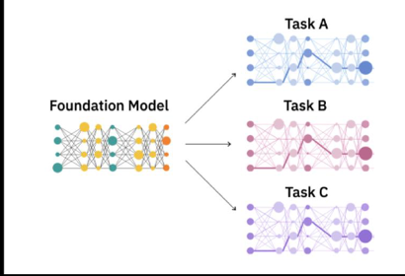
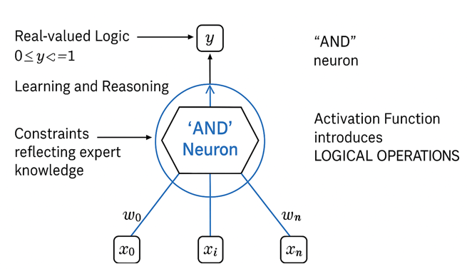
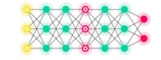
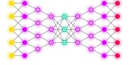
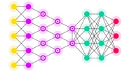
Integration of learnable logic into Foundation Models
80s
80s to ~ 2010
Big Data
2010 – 2017+
Massive Data
+
Compute
Today
Self-supervision at scale
+
Massive Data
+
Compute
Future
Learnable Logic
+
Self-supervision at scale
+
Massive Data
+
Compute
Task A
Rules
Facts
SVM
ANN
…
SVM, …
Task B
Task C
Inference Engine
Expert Systems
Hand-crafted symbolic representations
Machine Learning
Task-specific hand-crafted feature representations
Deep Learning
Task-specific learnt feature representations
Foundation Models
Generalizable & adaptable learnt representations
Neuro-symbolic AI
Infusing logic and reasoning with generalizable and learnt representations
Paradigms which simultaneously contain the best powers of ML/NNs and KRR; could sharpen to all 3 reasoning types: inductive (learning), deductive (theorem proving), and abductive (probabilistic)
© 2023 IBM Corporation
33

Slide 34
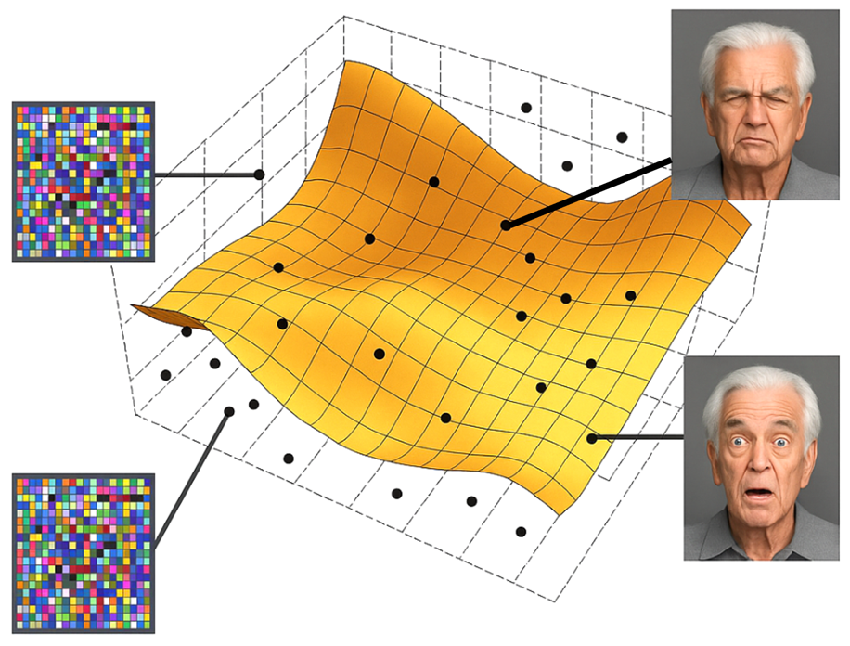
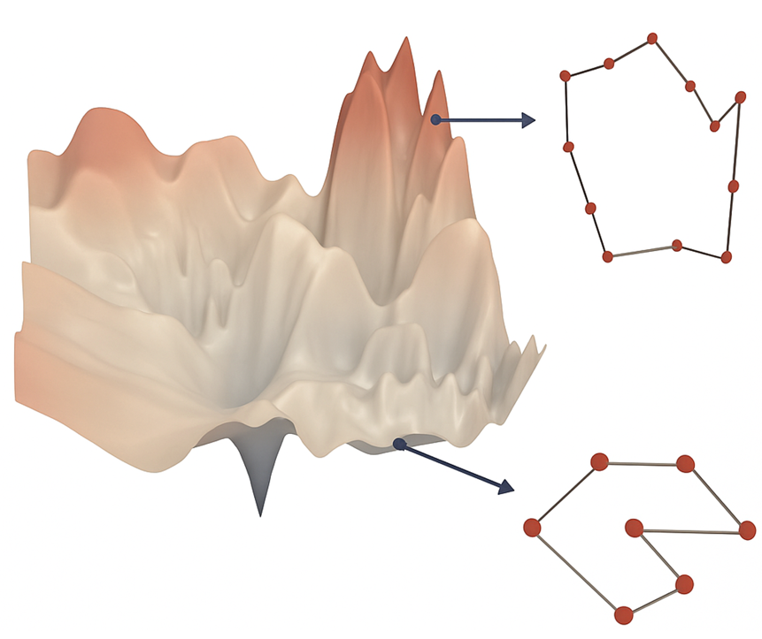
The Manifold Hypothesis
Vision/Language The manifold hypothesis holds.
Complex data can be represented using simple, shared features across the dataset (e.g., all faces have eyes).
Symbolic and Discrete problems The manifold hypothesis does not hold. Complex data lacks simple, shared features across the dataset.
Alvaro Velasquez, NSSS 2024

Slide 35
Computer Vision | Face recognition
Speech Recognition | Transcribing spoken English
Medical Imaging | Classifying chest X-rays
Autonomous Driving | Lane detection in highway scenes
Handwriting Recognition | Classifying digits (e.g., MNIST)
Manifold Hypothesis Likely Holds
Data has consistent, shared structure across samples.
Supply Chain / Logistics | Optimizing dynamic delivery networks
Cybersecurity | Detecting novel attack patterns
Scientific Discovery | Predicting outcomes of chemical reactions
Open-domain Dialogue | Free-form conversation with humans
Creative Writing / Art | Generating original stories or artworks
Manifold Hypothesis Likely Fails
Data varies in structure or lacks consistent representation.

Slide 36

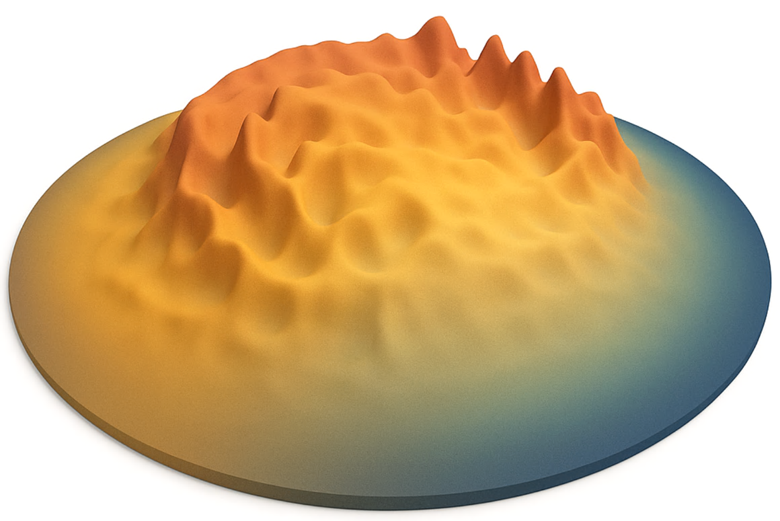
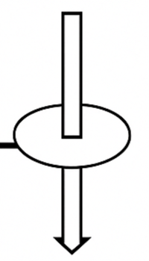
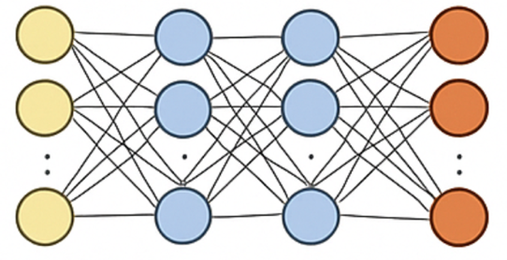
Sharper Manifolds → Poor Local Optima → Make Models Bigger
Neural Learning
Learning a representation of data in a low-dimensional latent space
Data
Training
Data-driven Update
Objective Function
Neural Network
Alvaro Velasquez, NSSS 2024

Slide 37

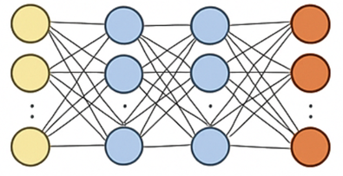
Neuro-Symbolic AI as an Antidote to Scaling Laws?
Hypothesis: Symbolic distillation
Discretized ML and smoothened symbolic reasoning can be integrated to reduce data requirements and create robust, assured, and therefore more trustworthy AI-based systems
Prior Symbolic Knowledge
Equations
Finite state machines
Logical constraints
Relational graphs
Visual concepts
Data
3
Symbolic update
Symbolic Space
4
Training
Smoothen
2
Inference
Discretize
Logic-based
1
Data-driven Update
Physics-based
Objective Function
Hybrid Neural Symbolic Network
Alvaro Velasquez, NSSS 2024

Slide 38
Learning with less data and cost
State-of-the-art LLMs cost 100M+ to train, and need massive energy
Theory tells us ML has fundamental limits in terms of data, thus compute cost needed
Human auditable and controllable
ML can only be indirectly controlled, primarily via data fed in, too large to vet
Current ML models cannot be read by humans in practice, and no clear way to put in human knowledge and constraints, e.g., to enforce factuality
Out-of-distribution generalization
ML has no other information it can use except for its training data
Theory tells us ML has fundamental limits in terms of how far it can generalize beyond training data, i.e., predict well for new unseen situations
Key Limitations of Current AI/ML Systems
Alex Gray, NSSS 2024

Slide 39
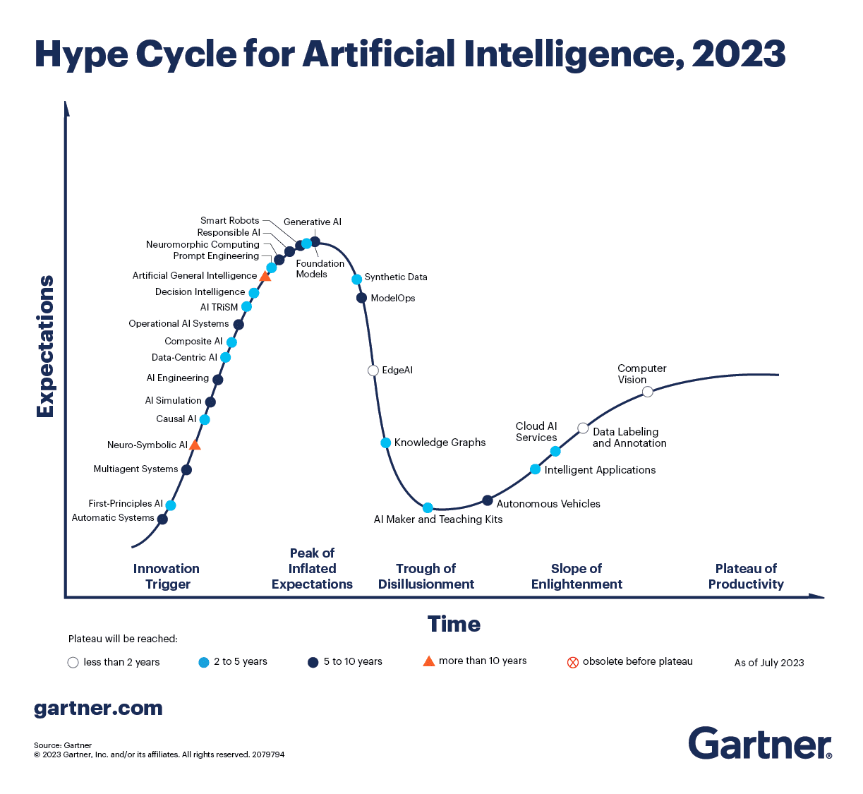

Slide 40
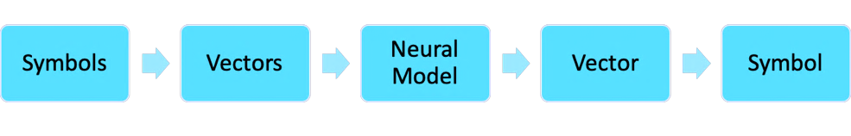
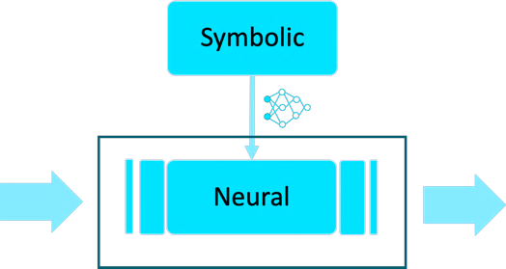
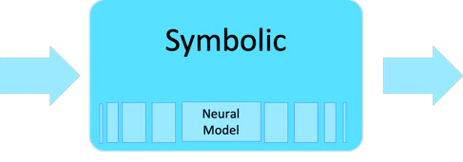
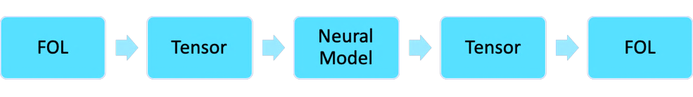
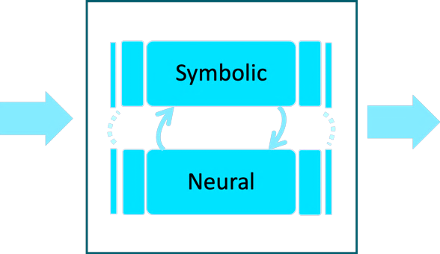
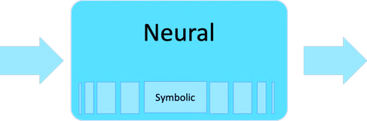
Taxonomy of Neuro-Symbolic AI
Source: Neuro-symbolic AI taxonomy by Henry Kautz & https://harshakokel.com/posts/neurosymbolic-systems/
1
Symbolic Neuro symbolic
Includes almost all deep learning NLP systems like Seq2Seq, Transformers BERT, etc.
4
Neuro:Symbolic → Neuro
Symbolic reasoning to generate data for neural system
2
Symbolic[Neuro]
AlphaGo system which uses a symbolic MCTS while using a neural state estimator
5
Neuro_{Symbolic}
Neural Theorem Prover, Logic Tensor Network
3
Neuro | Symbolic
Neural-Concept Learner is an example of this category
6
Neuro[Symbolic]
Allows a neural model to directly call a symbolic reasoning engine, e.g., to perform an action or evaluate a state
Notes:
Symbolic Neural symbolic—is the current approach of many neural models in natural language processing, where words or subword tokens are both the ultimate input and output of large language models. Examples include BERT, RoBERTa, and GPT-3.
Symbolic[Neural]—is exemplified by AlphaGo, where symbolic techniques are used to call neural techniques. In this case the symbolic approach is Monte Carlo tree search and the neural techniques learn how to evaluate game positions.
Neural|Symbolic—uses a neural architecture to interpret perceptual data as symbols and relationships that are then reasoned about symbolically. The Neural-Concept Learner[9] is an example.
Neural:Symbolic → Neural—relies on symbolic reasoning to generate or label training data that is subsequently learned by a deep learning model, e.g., to train a neural model for symbolic computation by using a Macsyma-like symbolic mathematics system to create or label examples.
Neural_{Symbolic}—uses a neural net that is generated from symbolic rules. An example is the Neural Theorem Prover,[10] which constructs a neural network from an AND-OR proof tree generated from knowledge base rules and terms. Logic Tensor Networks[11] also fall into this category.
Neural[Symbolic]—allows a neural model to directly call a symbolic reasoning engine, e.g., to perform an action or evaluate a state.

Slide 41

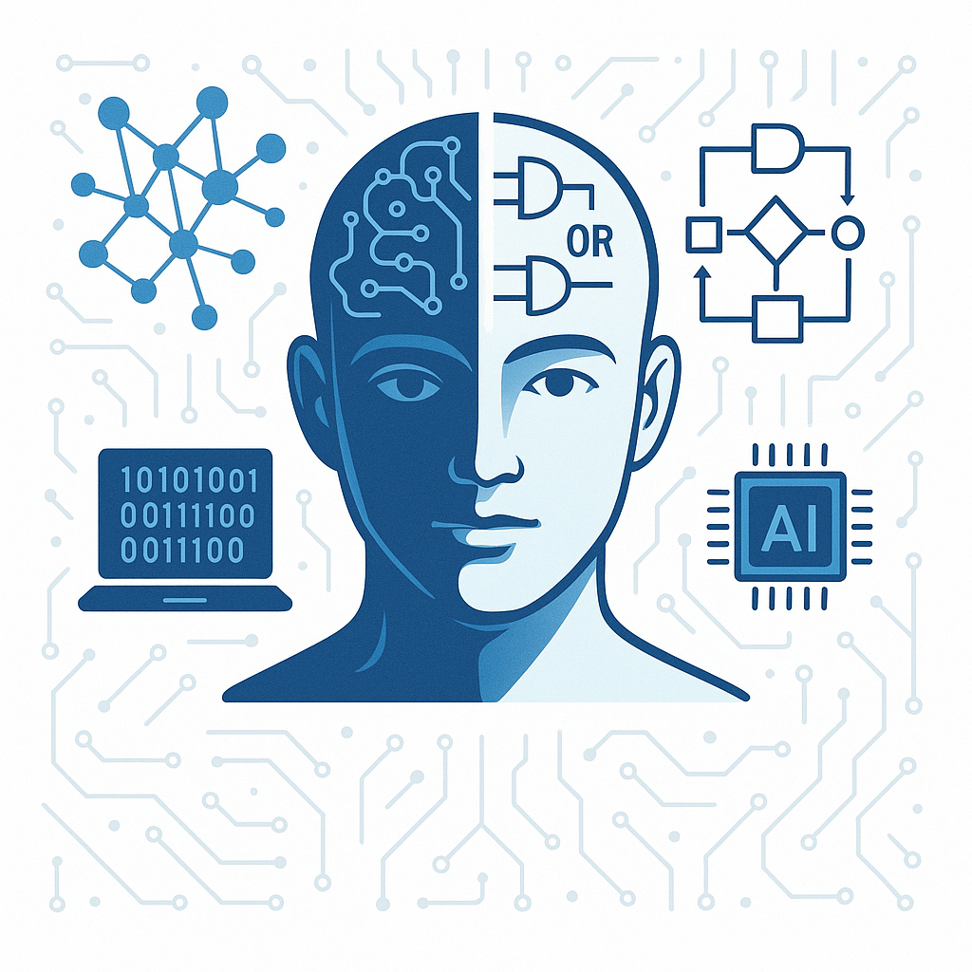
How are we using Neuro-Symbolic AI?
May 2024
May 2025
“Make an image of Neuro-Symbolic AI based AGI system” – OpenAI

Slide 42
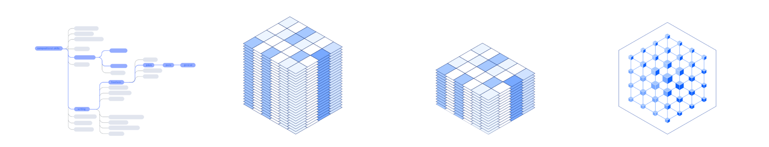
Image: InstructLab, IBM
Synthetic Data Generation with Neuro-Symbolic AI
Define the Domain
Data Generation with Teacher Model
Filter data with Validators
Train LLM with Distilled Data
Algorithmic Tasks
Rule-based tasks with clear steps and predictable outcomes.
May need external tools for complex computations.
Examples:
Math problems
Coding
Non-Algorithmic Tasks
Context-driven tasks with ambiguous or creative elements.
Often need world model.
Examples:
Summarization
Reading comprehension

Slide 43
Symbolic Controller
LLM
KG
DBs
LLM
LLM
RAG
Calc
Tools
LLM
Symbolic
LLM
Input
Rule
Induction
Gen
Output
Symbolic Controller with Neural Executors
Architecture: Symbolic system directs execution; neural modules handle perception or low-level tasks
Examples: Symbolic Decision Graphs, Neuro-Symbolic Concept Learner
Use Cases:
Multi-agent planning and coordination
Robotics with high-level symbolic plans and neural sensory processing
Complex decision-making with interpretable control flow
LLMs with Symbolic Tool Integration
Architecture: LLMs augmented with external symbolic tools or APIs via tool-use capability
Examples: Toolformer, OpenAI Function Calling, ReAct, Gorilla
Use Cases:
Agents that call calculators, databases, or solvers for accurate reasoning
Code interpreters, retrieval-augmented generation
Dynamic tool orchestration for complex tasks
Symbolic Reasoning Core with LLM Interfaces
Architecture: LLMs act as input/output translators around a symbolic reasoning engine
Examples: DRAGON, DSR (Deep Symbolic Reasoner), Knowledge Graph-enhanced LLMs
Use Cases:
Logical and rule-based reasoning over structured knowledge
Legal document interpretation and policy compliance
Scientific and mathematical deduction with formal constraints

Slide 44
Data Filtering
Data (gold, crawled, synthetic) has been growing exponentially
So is the need for filtering
Metrices based – e.g. Perplexity etc.
LLM as a judge – Prompting the model
Reward models (ORMs, PRMs)
Human Eval
Self consistency
Search
Semantic Deduplication
PII removal

Slide 45


IBM Granite Models
IBM and Meta co-launched the AI Alliance
Focused on fostering an open community and enabling developers and researchers to accelerate responsible innovation in AI while ensuring scientific rigor, trust, safety, security, diversity and economic competitiveness.
https://www.ibm.com/granite

Slide 46
Conclusions
LLMs exhibit emergent reasoning abilities, beyond simple pattern matching.
Yet, fundamental limitations—in consistency, grounding, and generalization—remain.
We must reframe LLMs: no longer just next-token predictors, but systems with latent reasoning potential.
Ongoing Research
High quality synthetic data
Agentic behavior with external tools
Inference time compute
RL methods
Benchmarks focused on real world problems
Future Focus
Neuro-Symbolic AI
Architectural changes
Knowledge and World models
True explainability

Slide 47




Thank you
youtube.com/@asimmunawar
x.com/asimunawar
linkedin.com/in/asimmunawar
Asim Munawar

